Slide 1

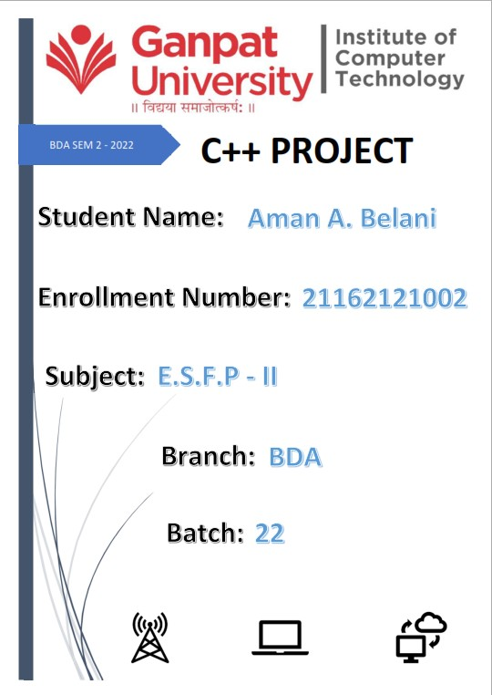

Slide 2
Synopsis:
Student Management System is a simple C++ program designed for educational institutions to manage student data and a variety of other student-related data needs. The user can build, show, and modify in this Student Management System project.
What is the meaning of Student Management System?
A Student Information System is another name for a Student Management System (SIS). These technologies let faculty members plan their schedules and communicate with one another about students. This approach was created to make data tracking easier for both parents and administrative personnel.

Slide 3
What is the objective of Student Management System?
The Student Management System’s major goal is to keep track of Profiles, Courses, Logins, Exams, and Fees. It keeps track of all information pertaining to Profiles, Students, Fees, and Profiles. Because the project is entirely constructed at the administrative level, only the administrator has access.
Why is student information system important?
One of the most important systems for the management and development of Higher Education Institutions is the Student Information System. It is critical to use it for academic decision-making and other academic responsibilities. Only Information Quality has a direct influence on satisfaction, according to the findings.
What is Student Management System?
Student Management System (SMS) This Student Management System C++ is built in the C++ programming language and is based on the notion of generating student information records and adding and updating them.

Slide 4
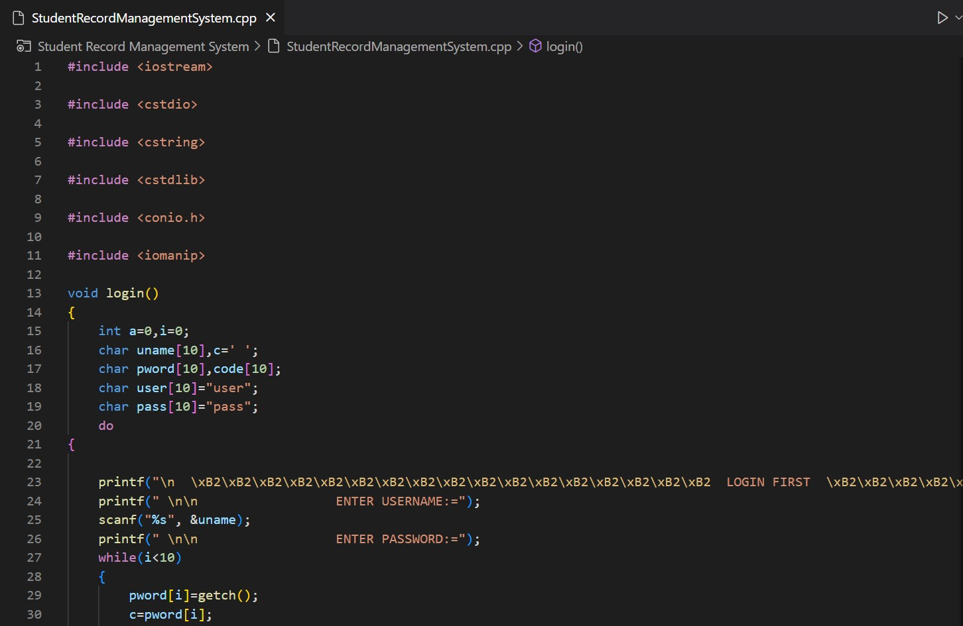
Source Code Screenshots:

Slide 5
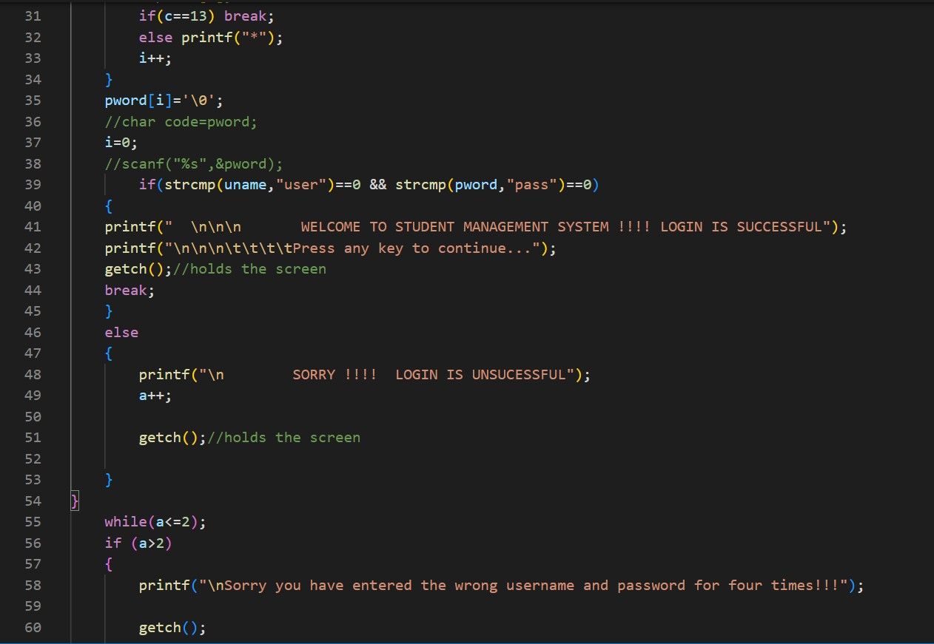

Slide 6
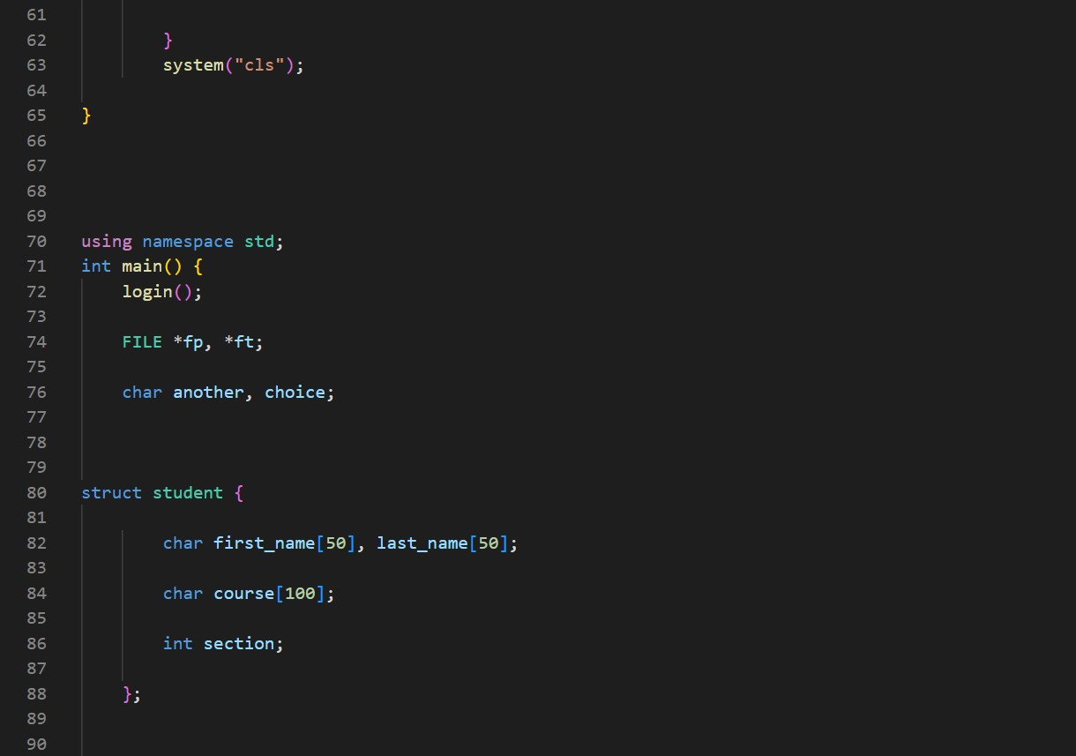

Slide 7
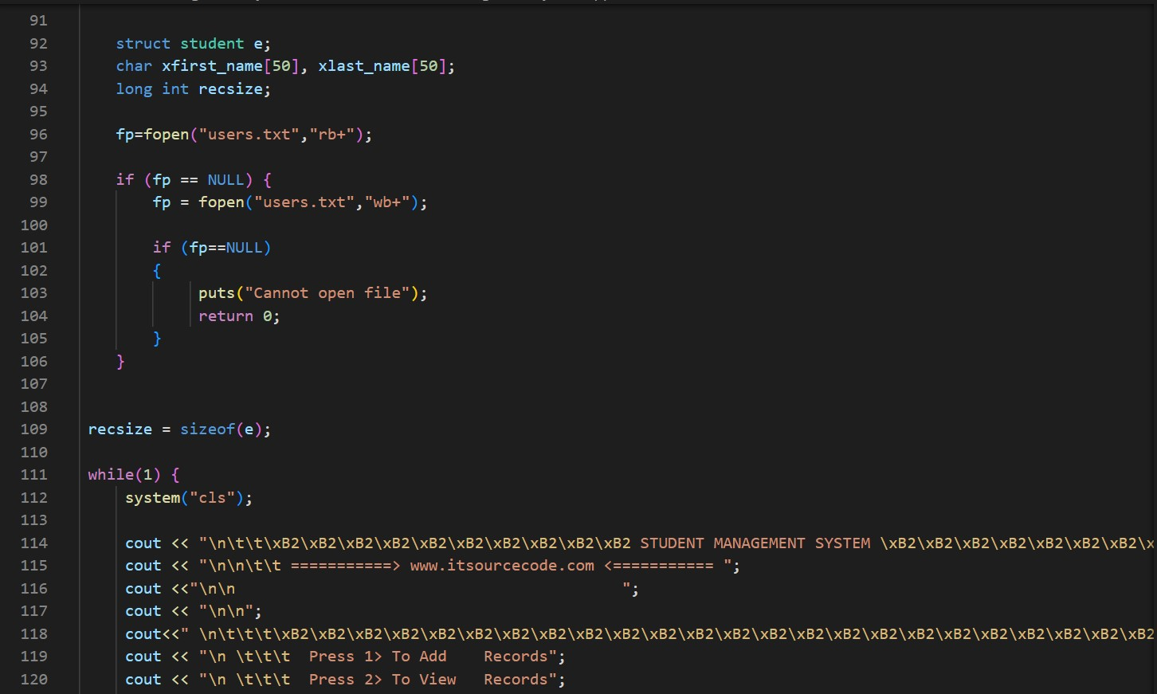

Slide 8
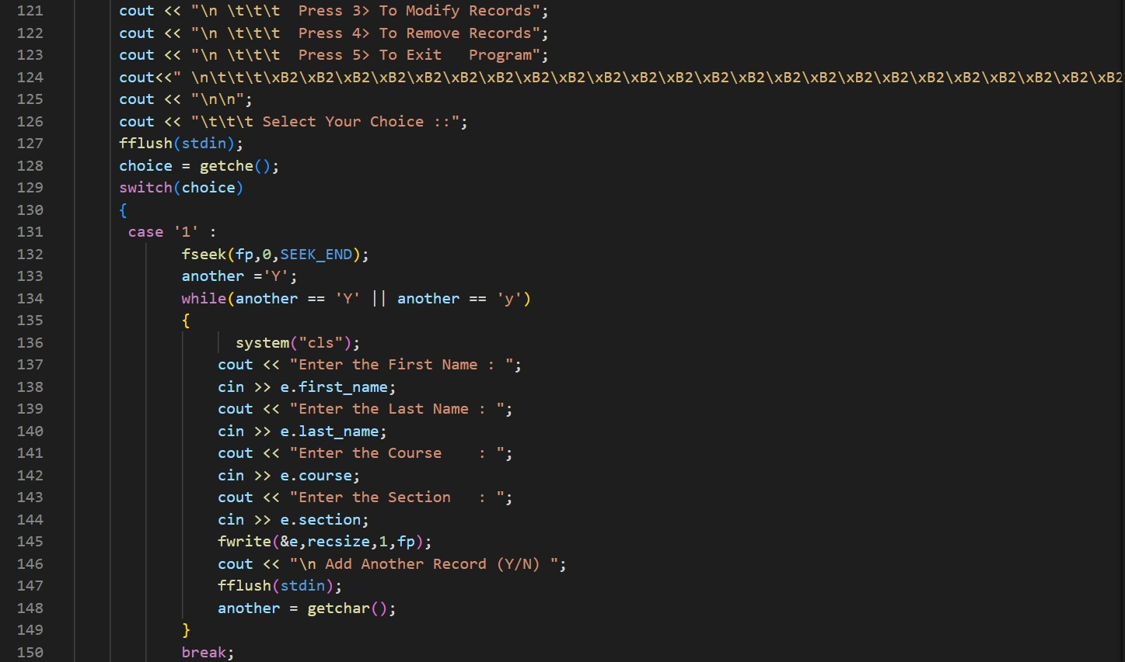

Slide 9
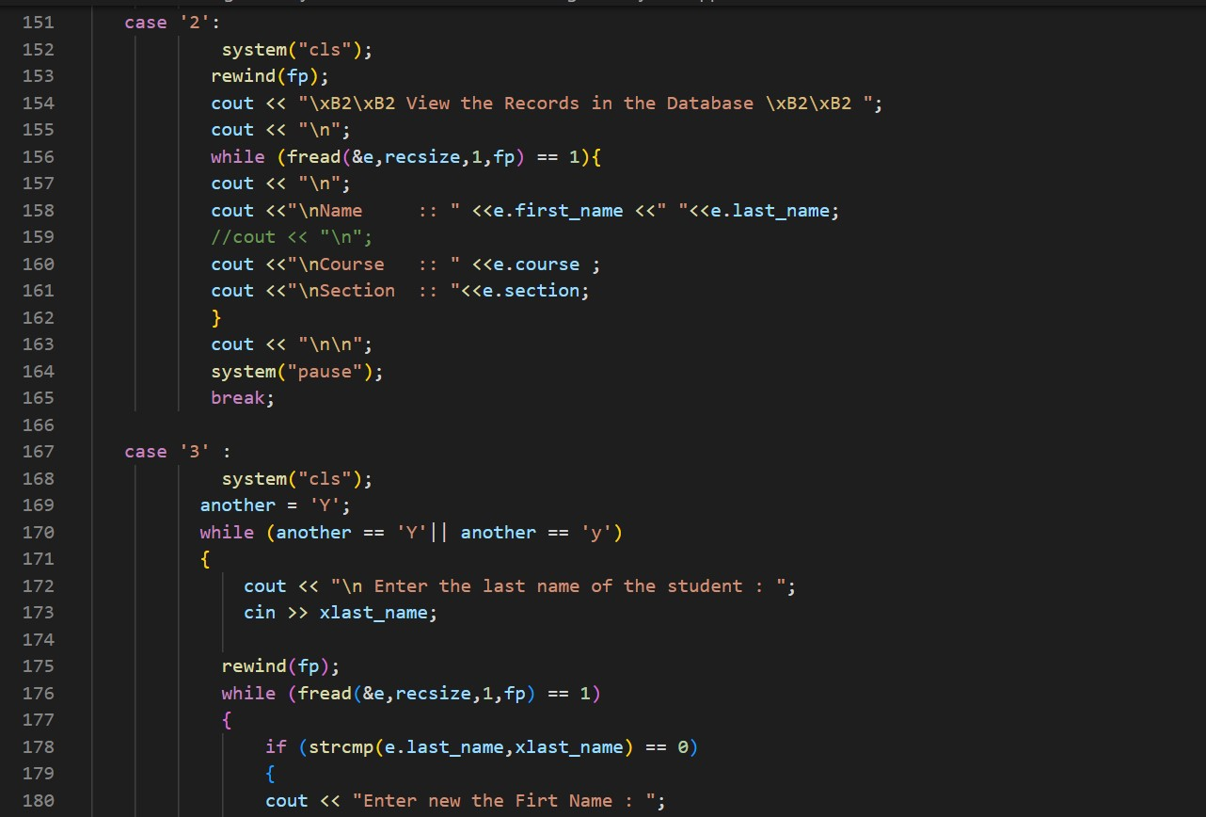

Slide 10
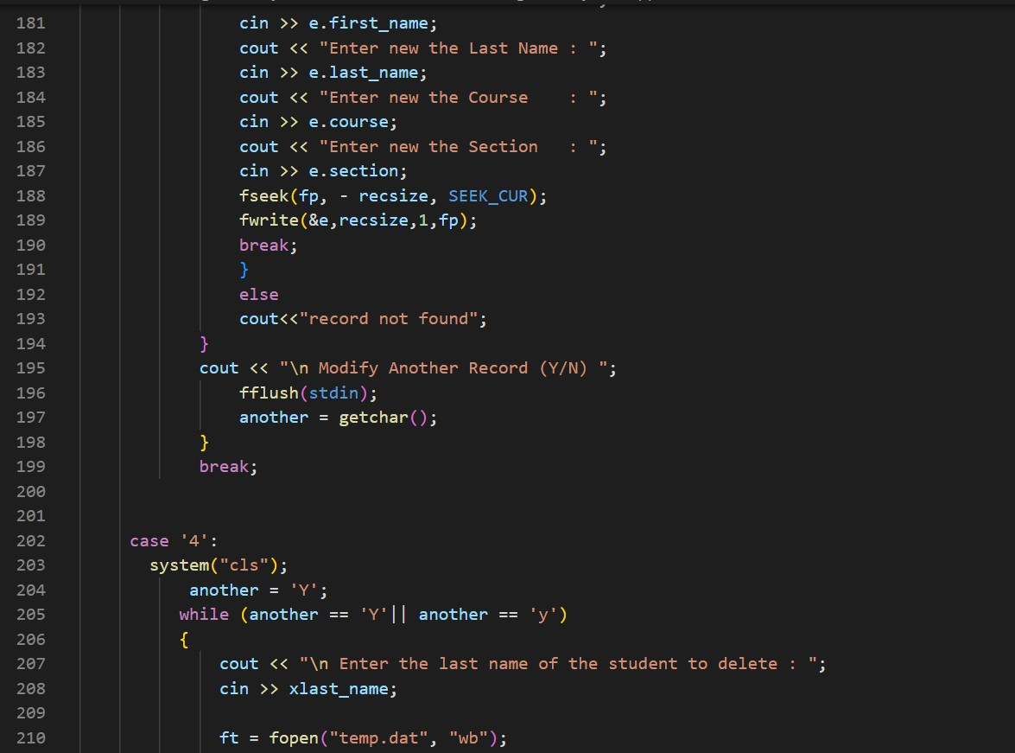

Slide 11
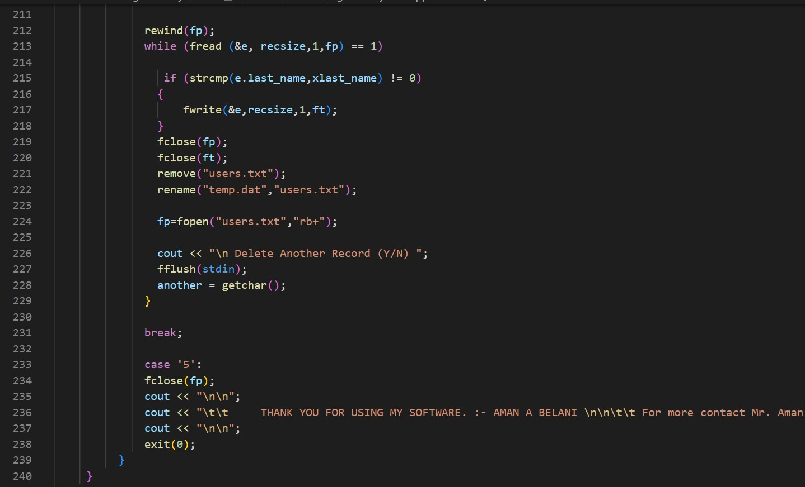


Slide 12
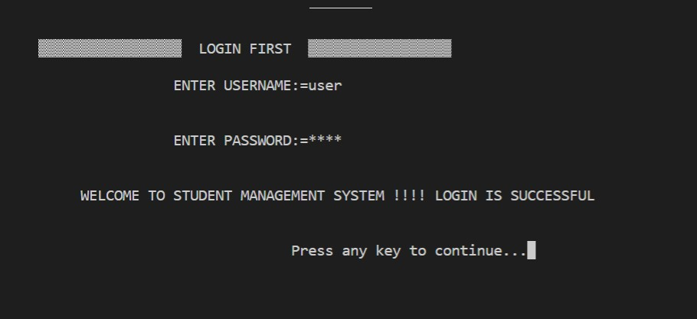
Output Screenshots:
a) Login Page

Slide 13
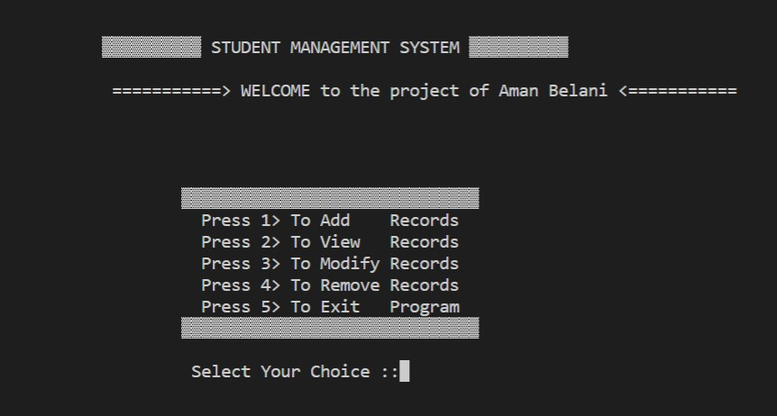
b) MENU Page:

Slide 14
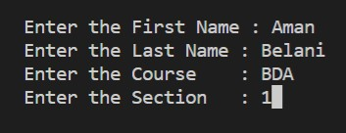
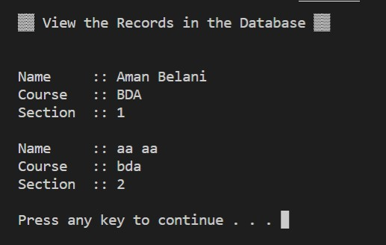
1) Add Records:
2) View Records

Slide 15
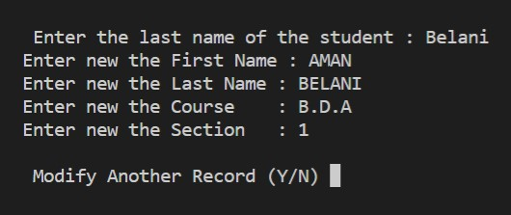
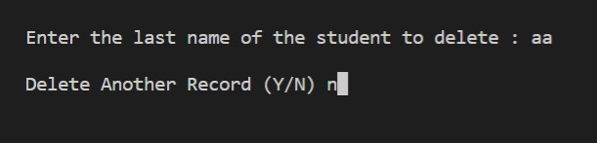
3) Modify Records:
4) Remove Records:

Slide 16
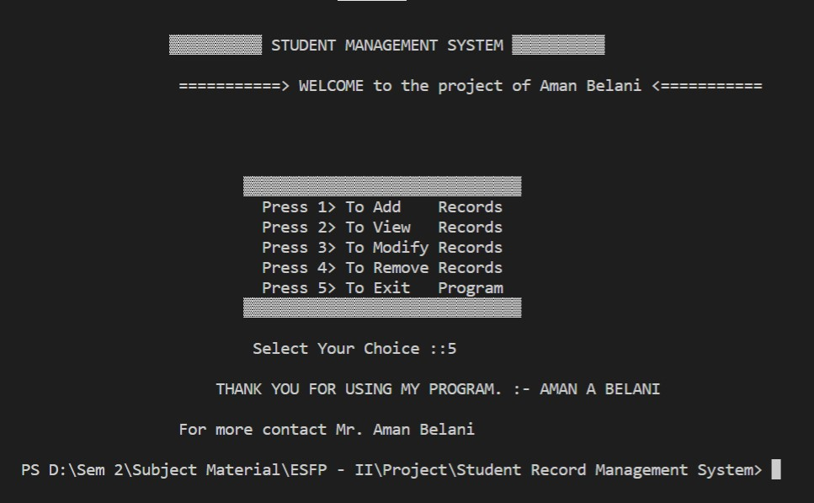
5) Exit Program:

Slide 17


